Slide 1
Contents
Introduction
Requirements
Problem Statement
Features
Advantages
Project Output
Conclusion

Slide 2
Introduction
ATM machine:
Automated teller machine enables the clients of a bank to have access to their account without going to the bank.
Performing few operations like
Withdraw
Deposit the amount
View the balance

Slide 3
Requirements
Core Java
JDK installed
Eclipse IDE

Slide 4
Problem Statement
This project is to make an automated teller machine with user’s account and password, bank account.
The system mainly used by the bank clients.

Slide 5
Features
My project is divided into two modules
* Checking Account
* Saving Account

Slide 6
Advantages
Quick and prompt service is possible .
It is beneficial for travelers.
Fast transactions.
Withdraw cash at any time

Slide 7
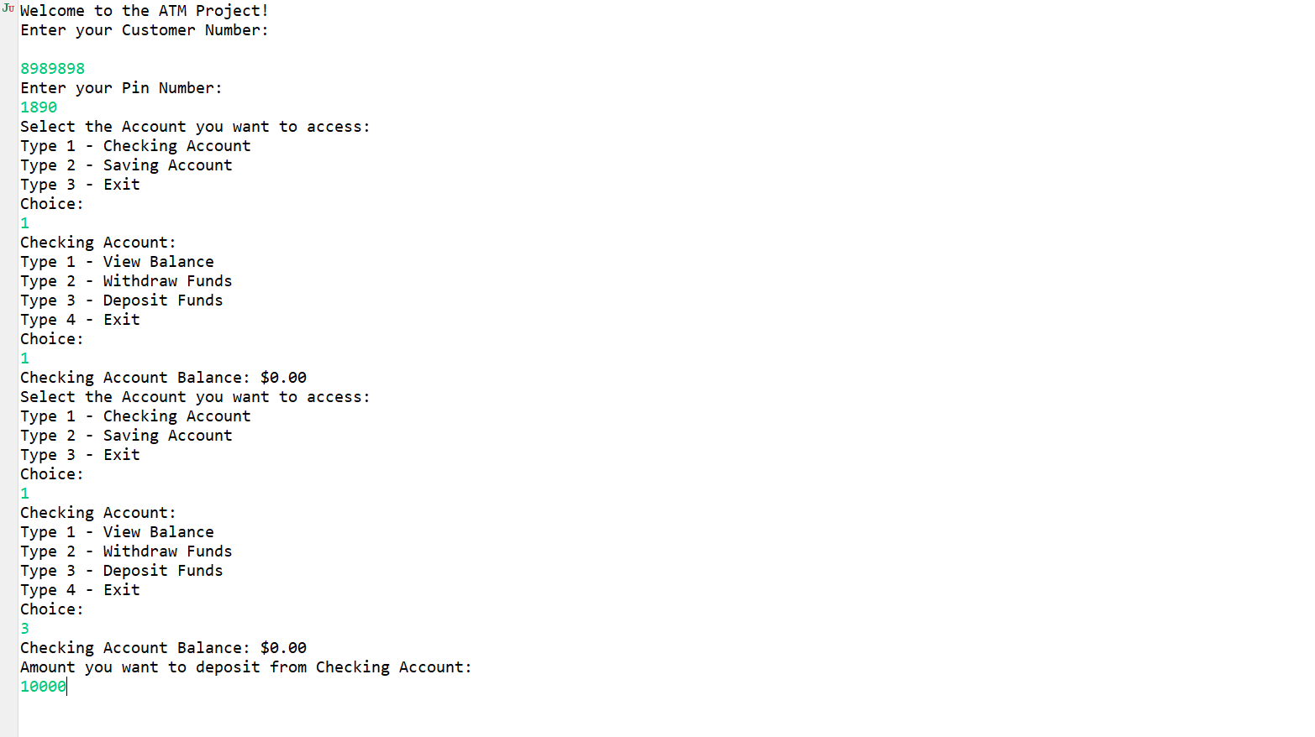
Output Checking Account

Slide 8
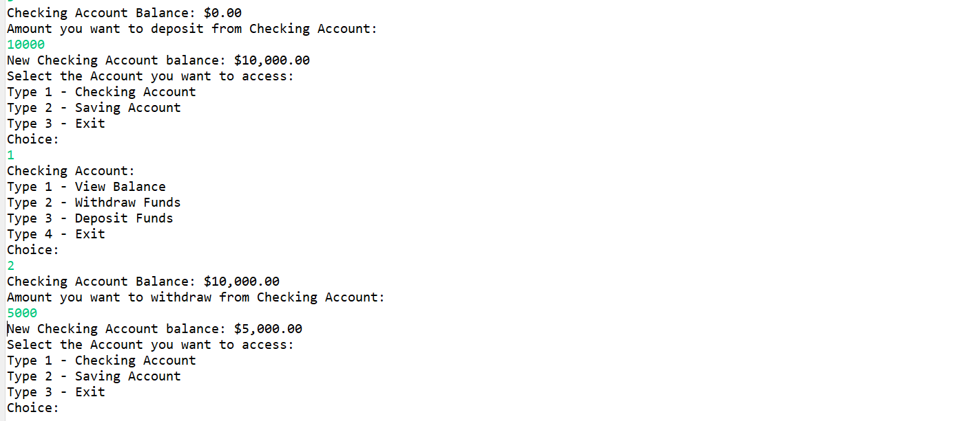

Slide 9
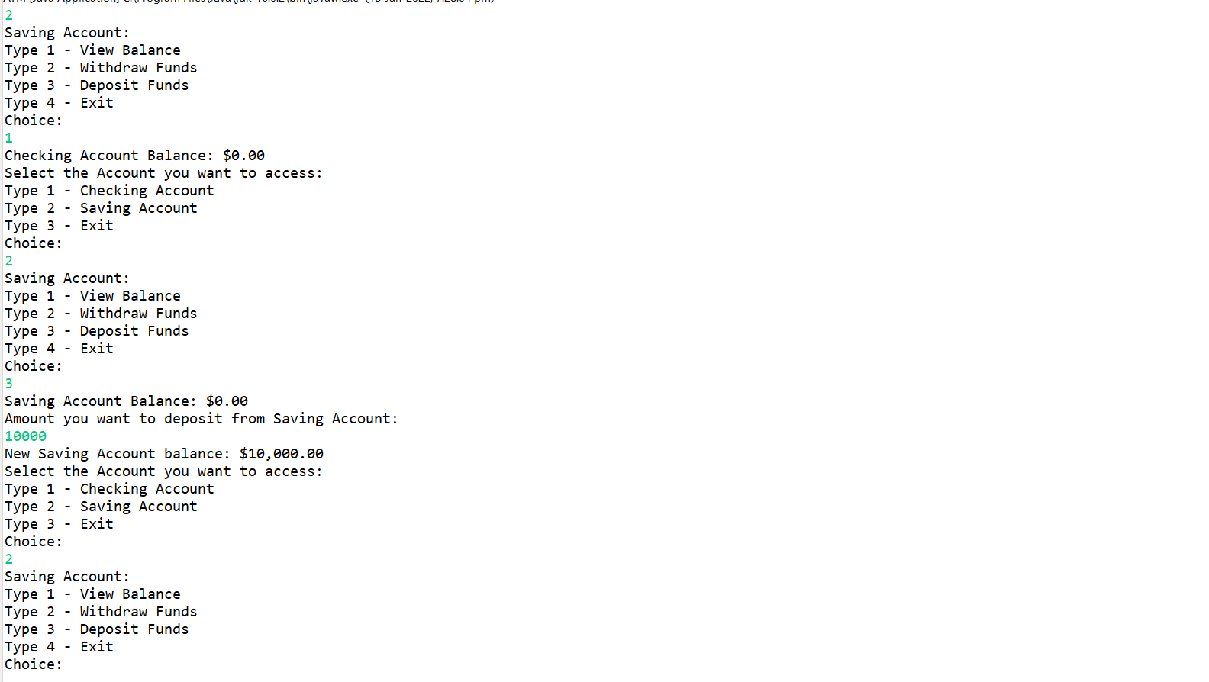
Saving Account

Slide 10
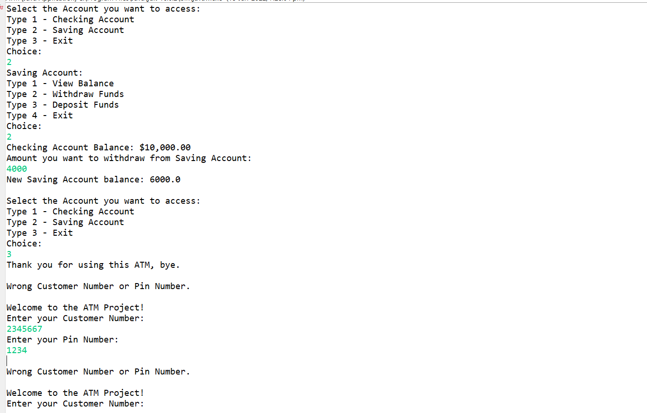

Slide 11
Conclusion
With the security of ATM improving it has now become a safe mode of transaction.
Hence it can be concluded that ATM is safe, fast, reliable, convenient, excisable, and any time money machine.

